Slide 1
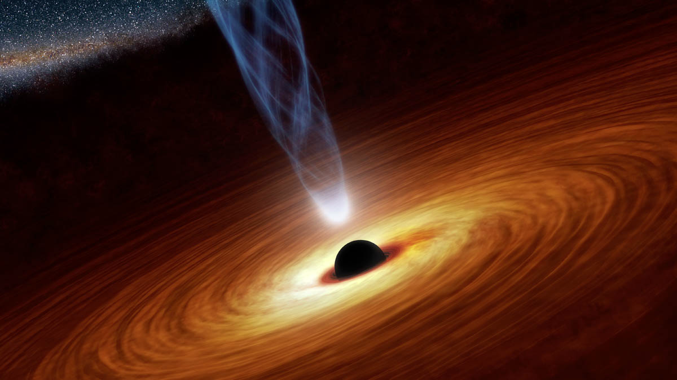
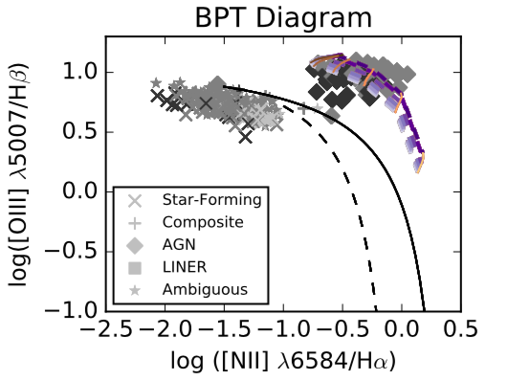
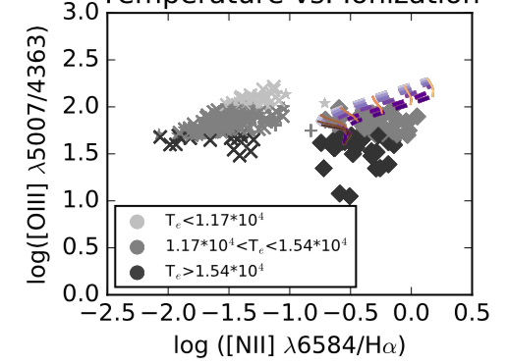
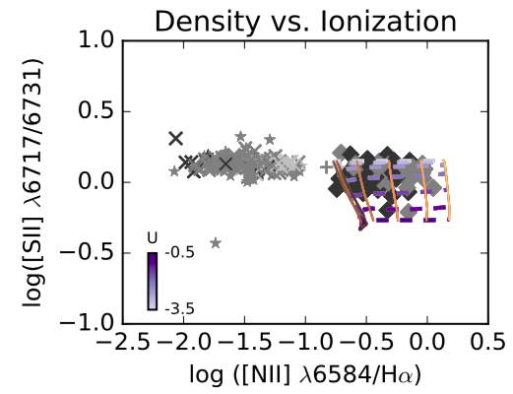
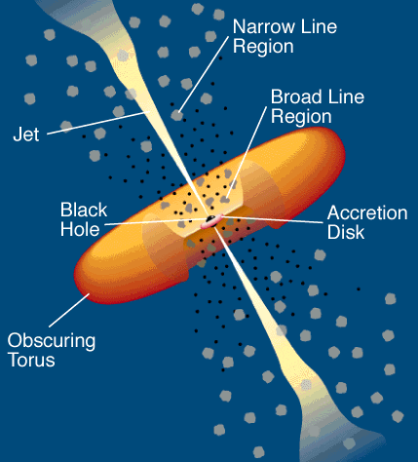
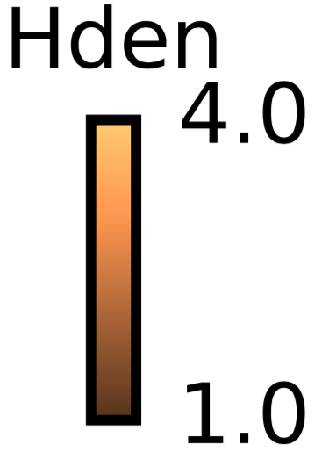
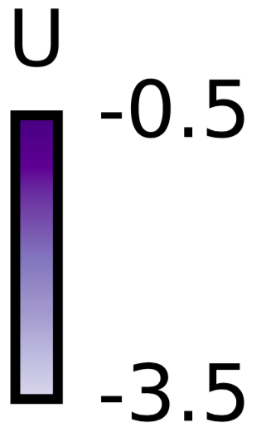
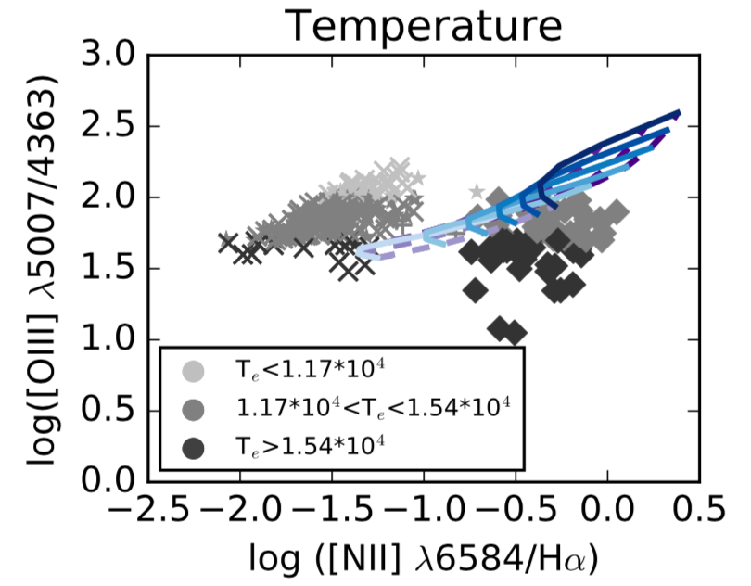
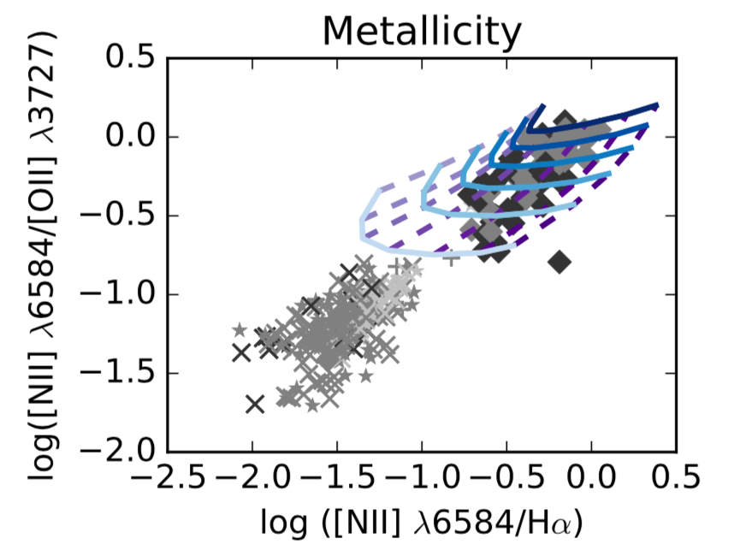
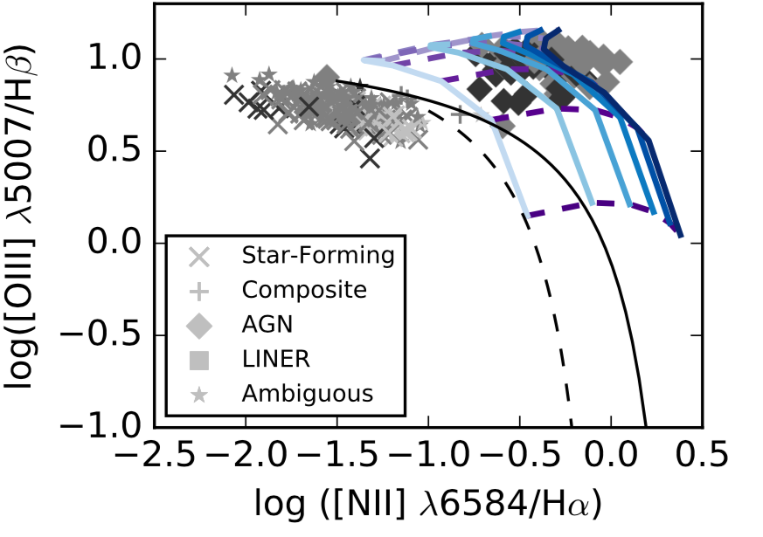
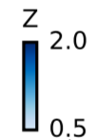
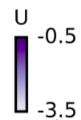
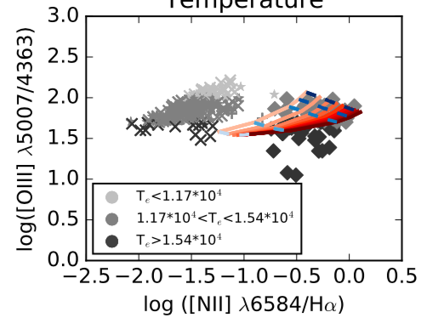
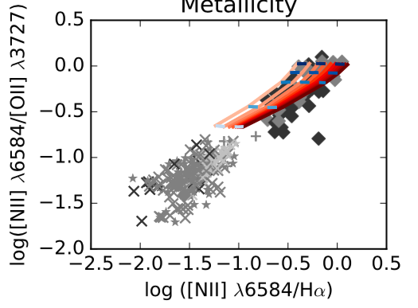
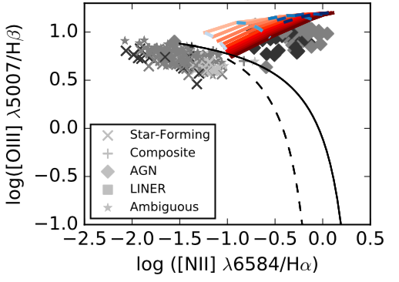
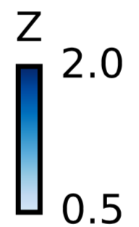
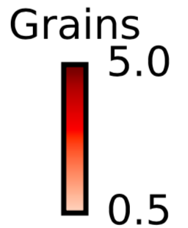
Investigating the Temperature Problem in Narrow Line Emitting AGN
Sam Jenkins, Dr. Chris Richardson
Elon University
Introduction
Results
Anomalously high electron temperature, T_{e}, in gas clouds around Narrow Line AGN
Decades old problem, but previous attempts at simulating high temperature AGN outliers have been unsuccessful, hence the “temperature problem” (Richardson et al. 2014)
We use a program called CLOUDY to simulate gas clouds and output emission lines when given various input parameters (Ferland et al. 2017)
BPT Diagrams
Temperature Diagnostics
Other Diagnostics
Methods
Original data set of 200,000 galaxies from Sloan Digital Sky Survey filtered to 469 by signal to noise ratio > 5.0 and redshift (z) > 0.4 (Albareti et al 2016)
Plot this data on diagnostic diagrams to investigate properties such as T_{e}, n_{H}, Z, U
Use CLOUDY to simulate clouds of these galaxies
Simulations run on SDSC Comet cluster, which cut run time from 24 hours to 30-45 minutes
Vary metallicity (Z), ionization parameter (U), grain content and hydrogen density (n_{H}), because of their effects on T_{e} and ionization, one at a time
Constant pressure maintained throughout all sims
Median Spectral Energy Distribution values were determined from Grupe et al., 2010, including ⍺_{ox} = -1.42, ⍺_{uv} = -0.57, and ⍺_{x} = -1.63
Find reasonable ranges of values for each parameter with help from literature (Osterbrock & Ferland 2006)
Adjusting simulation parameters to cover high T_{e} AGN on all plots
BPT separates AGN from Star Forming, etc.
n_{H} vs. U and Z vs. grains sims miss large portion of high temperature AGN on BPT Diagram while Z vs. U sims match almost all
Most high temperature AGN show 0.6 < Z/Z < 1.2 with grain content > 2.0
5007/4363 separates galaxies into temperature categories with highest temperature at lowest ratio
Grains sims produce highest temperature while maintaining [NII]6584/H⍺ ratio
High temperature Z vs. U sims miss high temperature AGN
High grain content and low Z produces highest temperatures due to decreased cooling effect and increased photoelectric heating
n_{H} vs. U and Z vs. U sims match almost all AGN which validates our chosen parameter values
Grains vs. Z sims match most AGN but miss some high temperature AGN
References
Future Work
Baldwin, J., Phillips, M., Terlevich, R., 1981, Astronomical Society of the Pacific
Richardson, C., Allen, J., Baldwin, J., Hewett, P., Ferland, G., 2013, MNRAS, 437, 2376
Grupe et al., 2010, ApJ, 187, 1
Osterbrock, D., Ferland, G., 2006, Astrophysics of Gaseous Nebulae and Active Galactic Nuclei
Albareti et al., 2016, arXiv: 1608.02013
Ferland et al., 2017, arXiv: 1705.10877v2
Acknowledgements
Conduct statistical analysis of results to determine how much of our high temperature AGN are matched by sims
Begin adjusting free parameters such as cosmic rays or turbulence to achieve higher temperatures
This project was done as part of Elon University’s Summer Undergraduate Research Experience, Summer 2017. I would like to thank Elon University’s Undergraduate Research Program and my research mentor, Dr. Chris Richardson. This project was conducted with support from XSEDE grant TG-AST140040.

